Slide 1
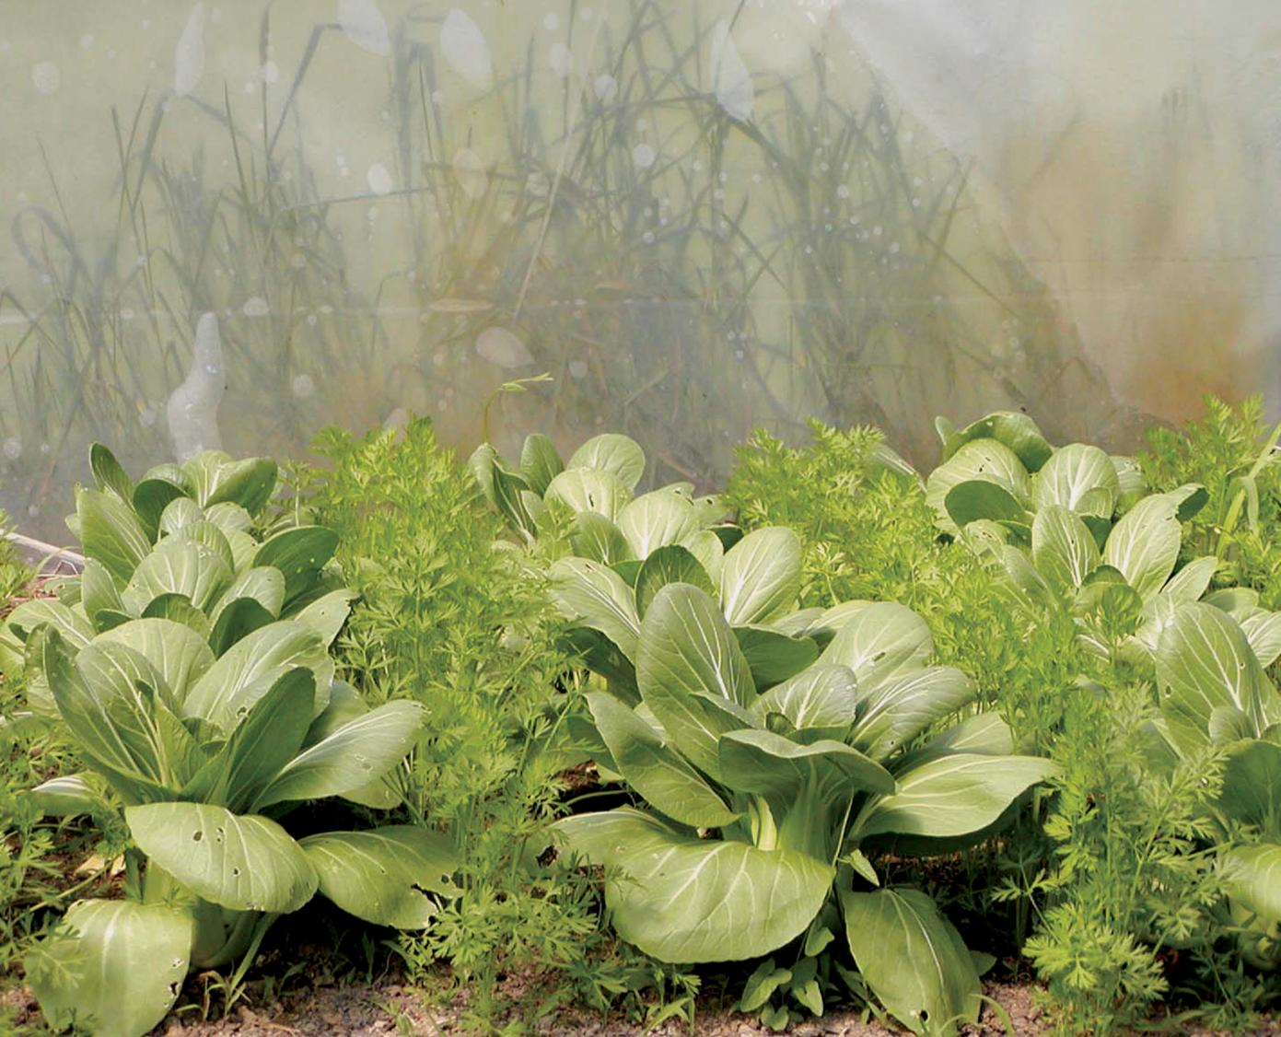
Introduction
NCR-SARE offices:
University of Minnesota
University of Missouri
Lincoln University in Missouri
photo credit: Abram Kaplan
Notes:
Welcome to this narrated PowerPoint presentation about how to apply for an NCR-SARE Youth Educator grant.
Youth Educator Grant projects provide opportunities for youth in the North Central Region to learn about Sustainable Agriculture — farming and ranching practices that are ecologically sound, profitable, and socially responsible.
Educators use these grants to encourage young people and their parents to try sustainable practices and see Sustainable Agriculture as a viable career option.
My name is Jean Andreasen, and I will be walking you through the online application process. This presentation will take approximately 20 minutes.

Slide 2
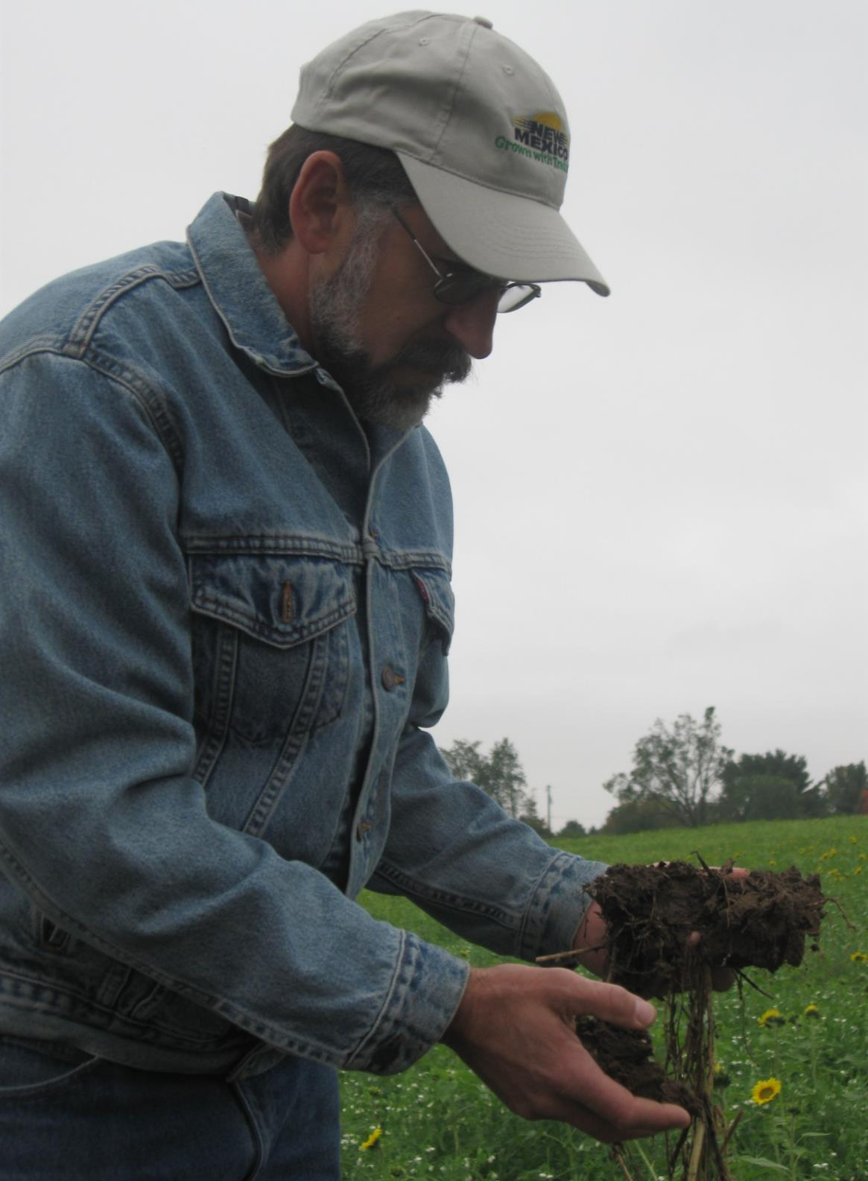
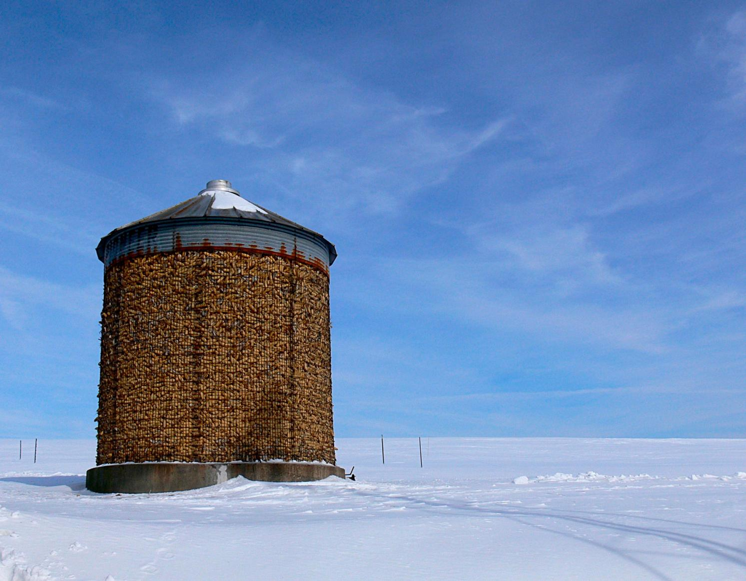
What is SARE?
Grants and outreach to advance sustainable innovations to
the whole of American agriculture.
Photo by Sean McGovern
photo credit: Abram Kaplan
Notes:
SARE is part of USDA and is funded through the National Institute of Food and Agriculture or NIFA program. SARE’s purpose is to provide grants and outreach to advance sustainable innovations to the whole of American agriculture.

Slide 3
Something New and Different
SARE was started in 1988, conceived as a
decentralized, science-based, grassroots, practical,
problem-solving,
and inclusive
competitive grant-making and outreach program.
photo credit: Joan Benjamin
Notes:
The program is run by four regions—North Central, Northeast, South and West, each guided by a volunteer Administrative Council that makes grants and sets regional priorities.
SARE is a decentralized, grassroots grant program in that each of the four regions makes its own funding decisions, including what type of grant programs to offer in their respective region.
NCR-SARE’s proposal review teams and the governing Administrative Council include regional farmers and ranchers, extension educators, researchers and personnel from state and federal agencies.

Slide 4
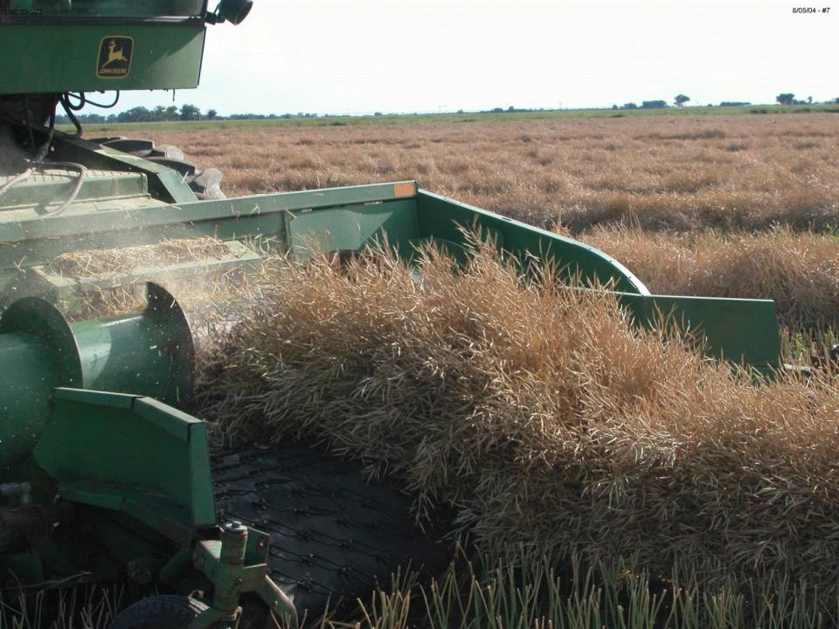
The SARE Model
The SARE Model
Four regional councils set priorities and make grants
SARE Outreach produces practical info
USDA-NIFA supports SARE
Other USDA agencies and land-grant universities are partners
photo credit: David Baltensperger
Notes:
The North Central Region of SARE consists of 12 states: Illinois, Indiana, Iowa, Kansas, Michigan, Minnesota, Missouri, Nebraska, North Dakota, Ohio, South Dakota, and Wisconsin.
SARE Outreach works with SARE's regions to share grantee research results with farmers, ranchers, educators, consumers and others interested in sustainable agriculture. SARE publications cover the gamut of sustainable agriculture practices, from books on cover crops and building soil health to bulletins on managing rangeland and water resources to online resources like Topic Rooms and videos.
SARE Outreach materials and information on all funded SARE grant projects can be found on the SARE website: www.sare.org
Before writing a proposal, determine a clear project goal and explore previous research. It often helps to contact NCR-SARE, local agriculture groups, NRCS and/or Extension educators to share ideas and invite participation.

Slide 5
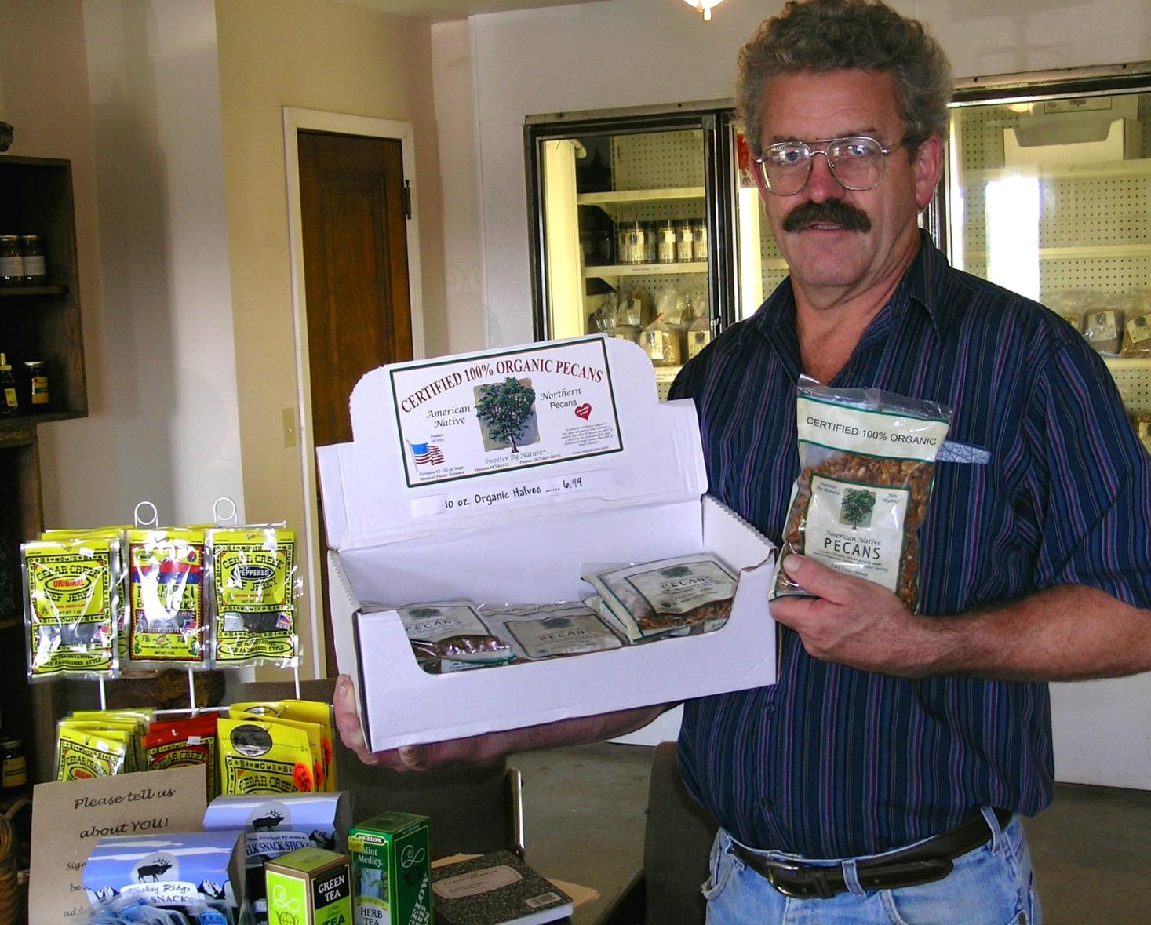
The Three Principles
The SARE Model
Successful SARE grantees are engaged in projects that are guided by the 3 principals of
_{sustainability…}
Stewardship of our nation’s land and water
Profit over the long term
Quality of Life for farmers, ranchers, and their communities
Photo by Jean Andreasen
photo credit: Ken Schneider
Notes:
Sustainable agriculture emphasizes the Economic, Environmental, and Social Impacts of agriculture. In your proposal, you should explain how your project addresses each of the three tenets of sustainable agriculture, even if it emphasizes one tenet over the others.
These grants are for sustainable agriculture research, demonstration, and education projects; they are NOT for everyday expenses or start up costs.

Slide 6
NCR-SARE Grants Funded 1988-2017
$69,425,678 awarded from 1988-2017
* Discontinued in 2012
Notes:
NCR-SARE has awarded over $69 M and funded over 2175 projects across the twelve state region since 1988. The Partnership Grant Program was recently added to the NCR-SARE portfolio and began funding projects in 2015.

Slide 7
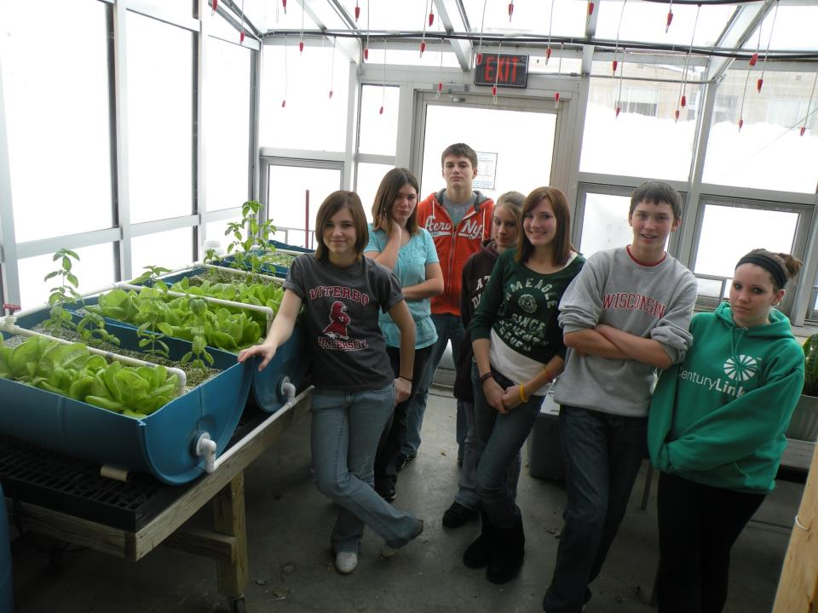
Youth Educator Grants
Grants for young people and educators to understand sustainable practices and see sustainable agriculture as a viable career option
Up to $4000 per project
Appropriate for vo-ag teachers or other youth educators
10 projects funded per year
Coordinated by Joan Benjamin
photo credit: Nathan Papendorf
Notes:
North Central Region SARE recognizes that youth programs are a way to introduce new and exciting farming and ranching options to youth, parents, and community members.
The Youth Educator program supports opportunities for youth educators to research, demonstrate, and learn more about sustainable agriculture.

Slide 8
Youth Educator Grants Funded 2008-2017
Notes:
Youth Education projects should help youth discover that sustainable farming and ranching is profitable; good for families, communities, and their quality of life; and good for the environment in the long term.

Slide 9
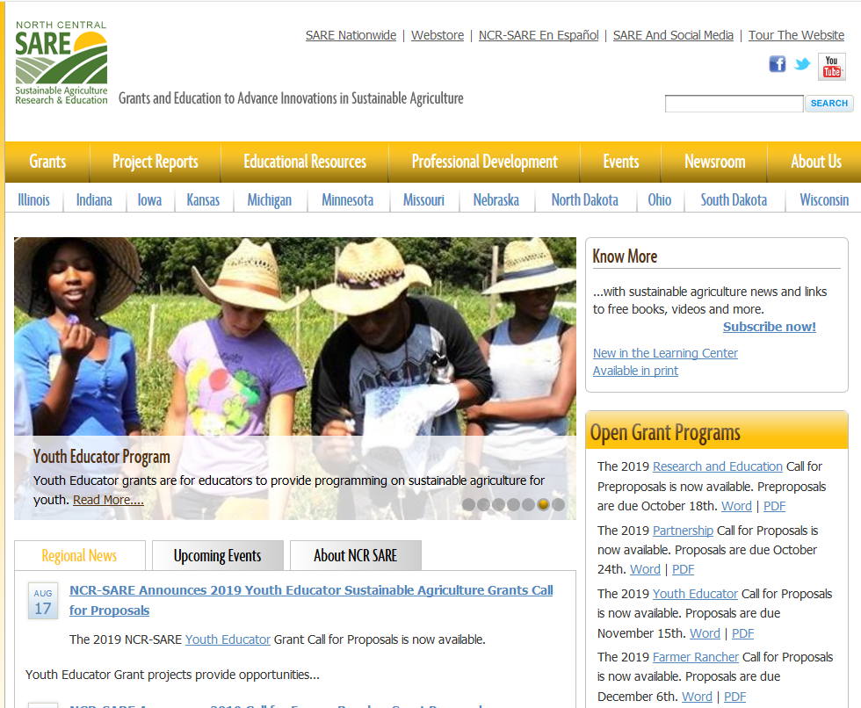
Download the 2019 Call for Proposals
Notes:
NCR-SARE uses an online submission system to take applications. Open grant calls for proposals for the various grant programs can be found in this section of our homepage. You will first want to download a copy of the current Call for Youth Educator Grant Proposals. It contains directions and the application. Download the Word version so you can use it to work on a draft of your proposal. Make sure you have the current call, as there are changes from the previous call. If you have any problems downloading the call for proposals, please contact the NCR-SARE office and we can send you a copy either by email or US post. Online Submission Deadline is 4:00 p.m. CST, Thursday, November 15, 2018. If you are unable to use the online system, you may submit a proposal by mail or e-mail. Mail and e-mail submissions must be received by 4 p.m. CST on Thursday, November 15, 2018 at the Saint Paul NCR-SARE Office. Proposals sent by Fax will NOT be accepted.

Slide 10
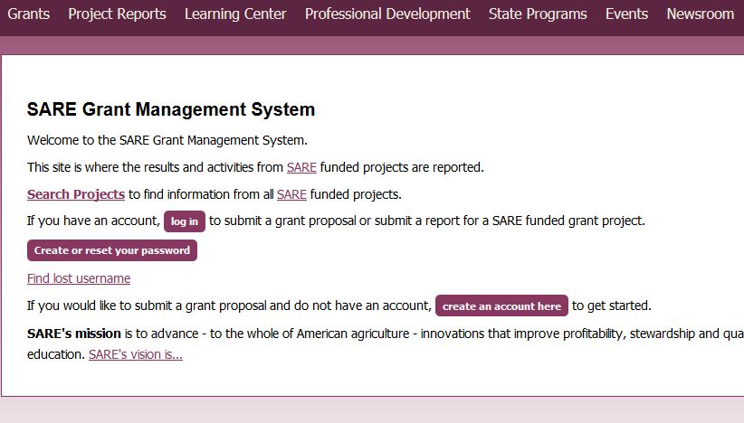
https://projects.sare.org/
Notes:
To begin the process of applying for your NCR-SARE Youth Educator grant, you must go to www.projects.sare.org The application process will go more smoothly if you have your grant written in a word processing program prior to going to the application site. This will allow you to copy and paste your text directly into the spaces provided on the site for the information asked for in the call for proposals. It will also allow you to check the word count in advance, to make sure that each response complies with the application word limits. I’ll now guide you through using the online application system. If you’ve never had a SARE grant before, you’ll first need to create an account and complete your user profile. Go to projects.sare.org and click on “create an account” If you’ve had a SARE grant previously and filed reports in this system, your profile will already be in the system and you can log in with the information you used for reporting.

Slide 11
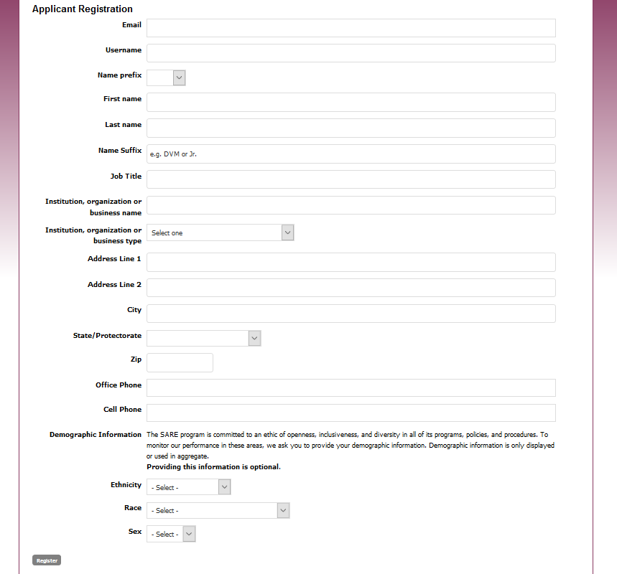
Notes:
Complete the requested information. Click on Register in the lower left hand side of the webpage. Information regarding this application will be sent to the email address you provide here. We also request demographic information. The North Central Region SARE program is committed to an ethic of openness, inclusiveness, and diversity in all of its programs, policies, and procedures. To monitor our performance in these areas, we collect demographic information. Demographic information is not linked to your proposal. You may choose “prefer not to answer” to each demographic question. If you have questions, please contact Joan Benjamin.

Slide 12
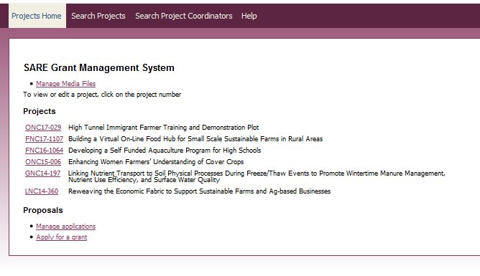
Notes:
Once you have completed the information and logged into the system, you’ll see this screen. Under projects, you’ll see a list of all projects you’ve been associated with. Under proposals, you’ll see a link to manage applications. This is for you to edit proposals you’ve started but not submitted.
Click on “apply for a grant” to start a new proposal.

Slide 13
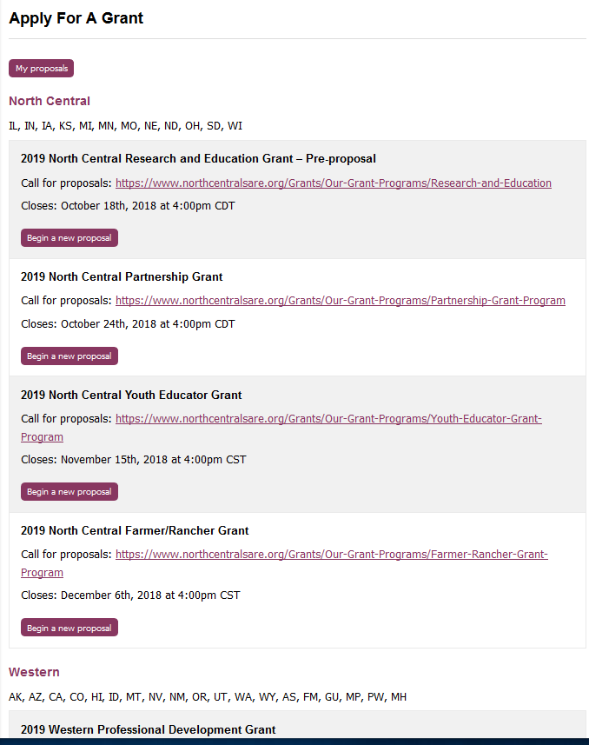
Make sure you choose the correct grant program and the North Central Region
Click on “Begin a new proposal”
Notes:
You will see a list of all open grant applications, for all regions.
Make sure you choose the correct grant program and the North Central Region. You will be completing the 2019 North Central Youth Educator grant application.
Click on “begin a new proposal.”

Slide 14
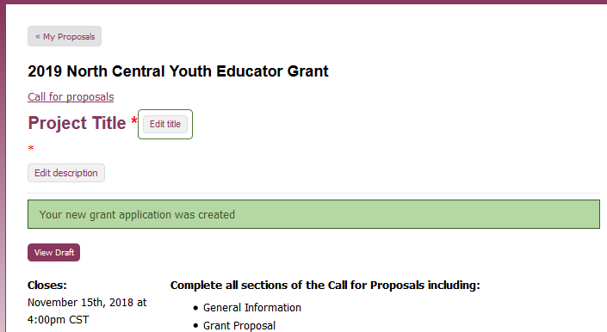
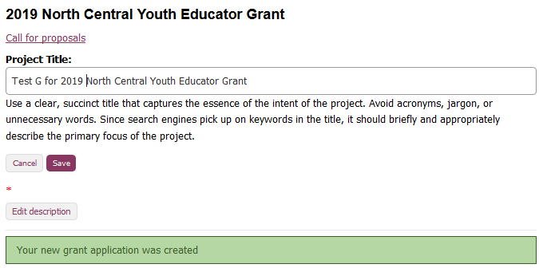
Click on
“edit title”
Then enter your title in the space provided.
Click on “save”
Notes:
Items that must be completed are marked with a red asterisk. Click on “Edit title,” then type in the title of your proposal in the space provided. This lets reviewers know what your project is about – be descriptive but not too wordy. Use key words that are useful for finding your project in a website search, keeping the title to 25 words or less. Click on save to save your title. Note that throughout the application, you must click on “save” after every entry to save the information you’ve entered.

Slide 15
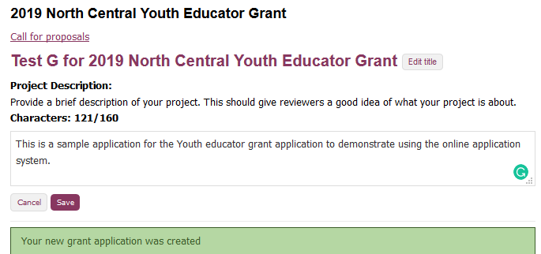
Click on
“edit description” and enter a brief description.
Note that for answers with character or text limits, the system tracks your word/character count.
Click on “save”
Notes:
Click on “Edit description” and provide a brief project description (less than 160 characters). Click on “save” to save the description.
If an answer has a character or word limit, the system tracks the entry so that you know when you’re running out of room.

Slide 16
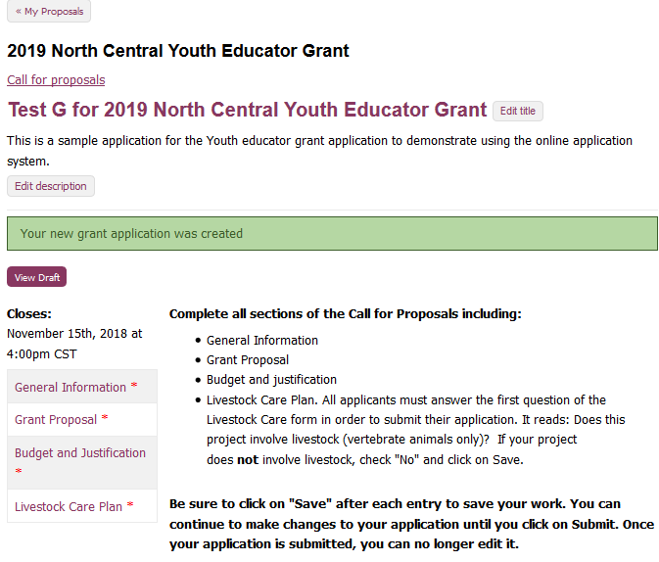
Click on
“General information” to answer the questions in that section.
Notes:
You’re ready to move on to the first section of the application, “General Information.”

Slide 17
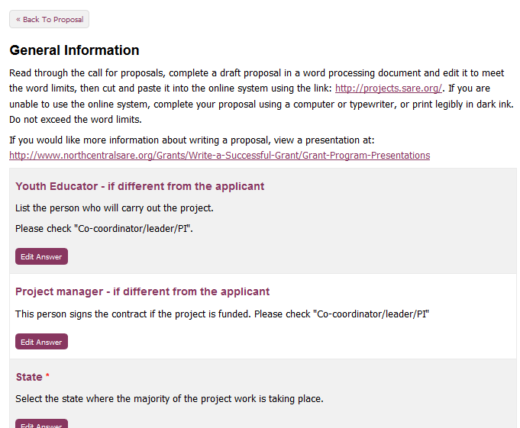
Notes:
This section contains information and instructions that are included in the Call for Proposals. Scroll down to complete information for each question, by clicking on the “edit answer” button and completing the information. Note that some boxes have drop down menus that will be visible when you click on “select” in the box.

Slide 18
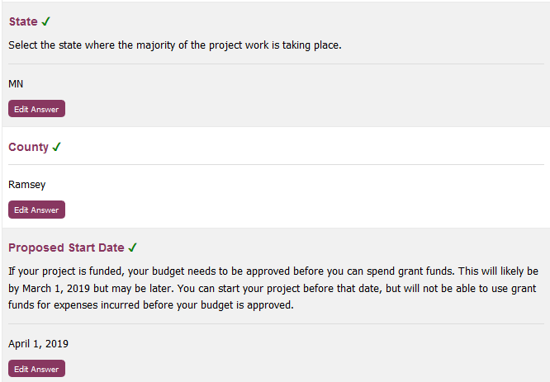
When a question is completed and saved, a green check mark appears.
You can change your answer by clicking on “edit answer” and resaving.
Notes:
Once you have completed and saved an answer, a green check mark appears next to that question.

Slide 19
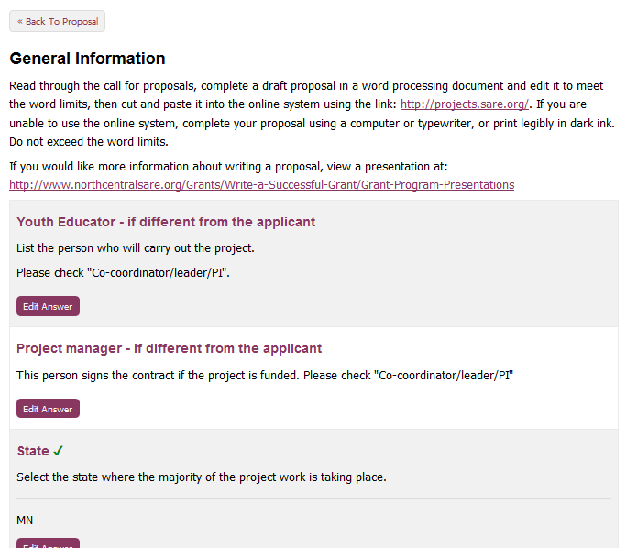
When you have completed this section, scroll to the top of the webpage and click on “Back To Proposal.”
Notes:
Once you have completed all required and applicable information and saved all information in the General Information section, scroll to the top of the web page and click on “Back To Proposal.”

Slide 20
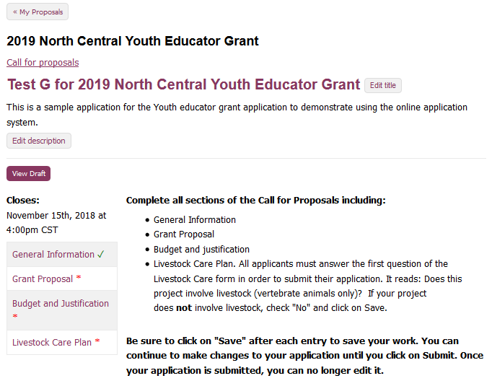
The green check mark by “General Information” confirms that you have completed all required information for that section.
Click on “Grant Proposal” to complete the next section.
Notes:
The green check mark by “General Information” indicates that you have completed all required information for that section. You can proceed to the next section, “Grant Proposal.”

Slide 21
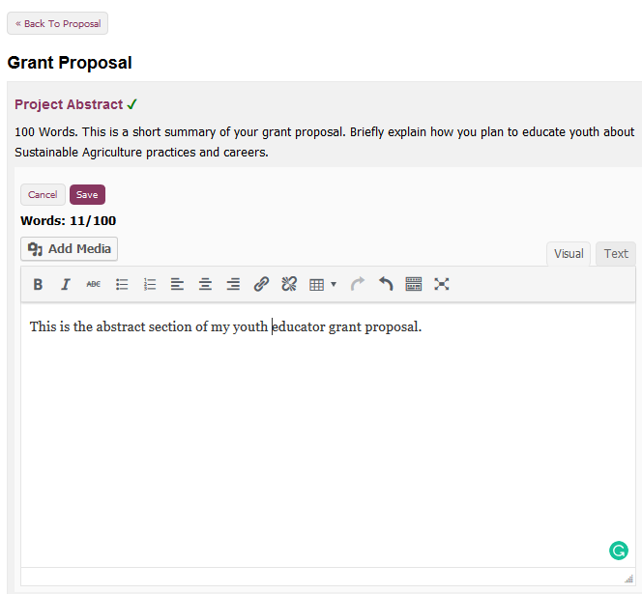
Complete the information for each question and “save.”
For text sections with word limits, the system tracks your entry.
Notes:
Answer each question in this system. The system will show you how many words you have used so you don’t go over the limit. In this example, 11 out of 100 words have been used.
Don’t forget to save your answer.
Once you’ve completed all required questions and saved your answers, you can scroll to the top of the webpage and click on “back to proposal”

Slide 22
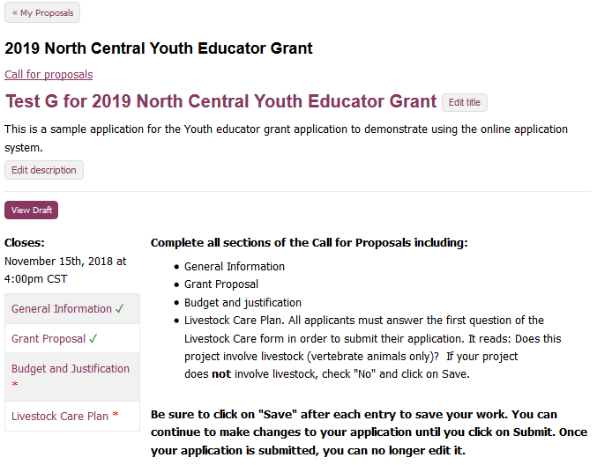
On the main page, you’ll see you’ve successfully completed the first two sections.
At any time, you can click on “view draft” to view your proposal, or to share a draft with a collaborator.
Notes:
Return to your main proposal page. You’ll see you’ve successfully completed and saved all required information in the first two sections.
You can view a draft of your proposal by clicking on “View Draft”. This function also provides a link to the draft that you can share with collaborators.

Slide 23
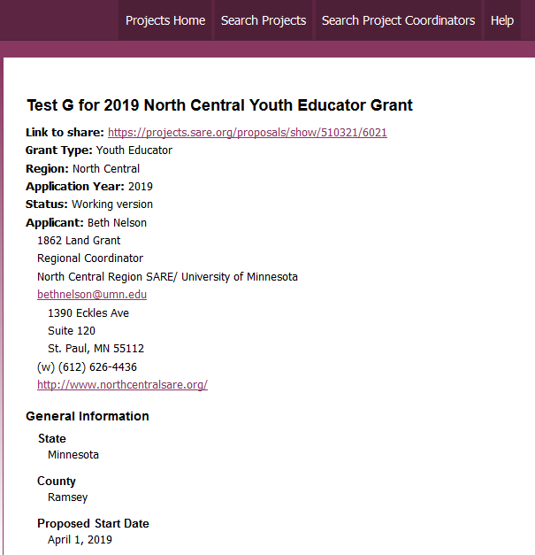
This is the “draft”. You can share the link with collaborators, or print off this draft.
To return to your proposal, close the “draft” window.
Notes:
When you click on “draft”, it will give you this page. You can give the link to collaborators and they’ll see this same draft. To return to your proposal, you'll close the draft window.

Slide 24
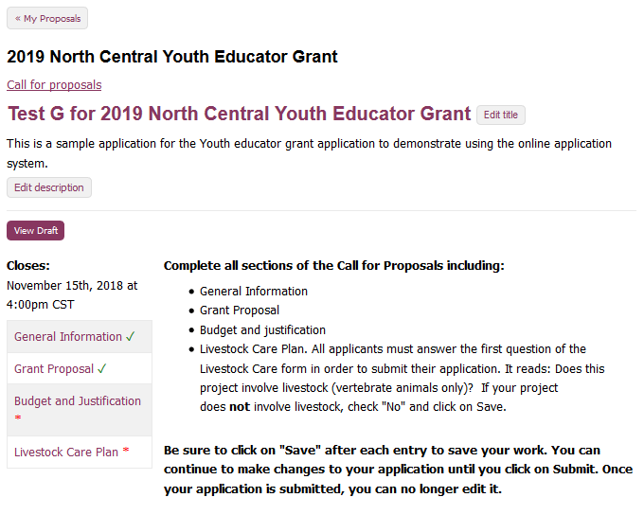
You’ll now enter your budget information.
Notes:
You're now ready to complete the budget section.

Slide 25
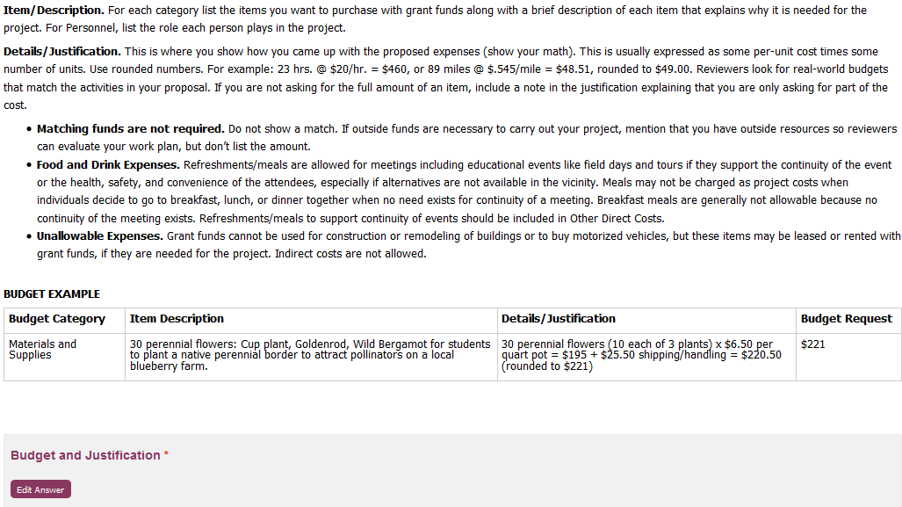
Follow the guidelines to enter each item of your budget.
Notes:
Follow the guidelines provided to enter each item of your budget.

Slide 26
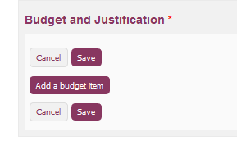
Follow the guidelines to enter each item of your budget.
Notes:
Click on “Add a budget item” then click on “budget category”. Choose the category for the item you are entering. The drop down menu gives you a choice of several categories.

Slide 27
Notes:
Complete the Item Description. Under Details/Justification, follow the budget guidelines to show how you calculated the total cost for that item. You can add another budget item to stay on the same page, but none of the information will be saved until you click on the save button.

Slide 28
Notes:
Here’s a sample budget. Once you’ve entered all of your items, scroll to the top of the webpage and click on “back to proposal”.

Slide 29
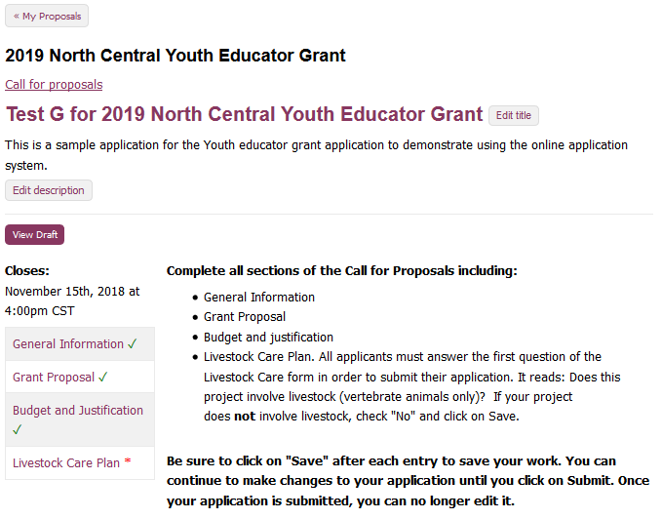
Notes:
Once you’ve completed the three required sections, go to the Livestock Care Plan section, even if your proposal doesn’t use livestock. You must answer “no” in that section in order to complete all requirements. If your project does use livestock, please answer the questions in the animal care form in that section.

Slide 30
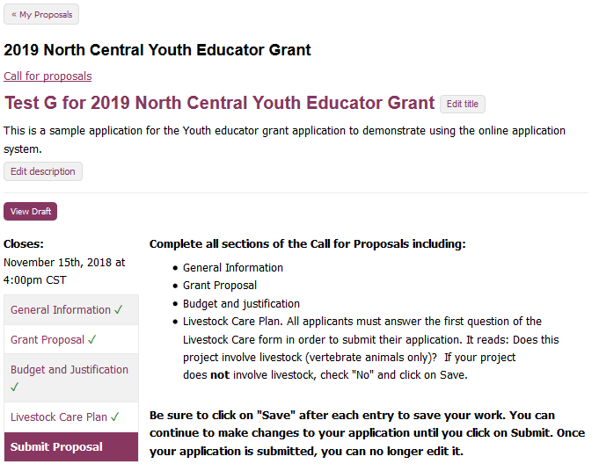
Notes:
You’ve now completed all required sections, and are ready to submit the proposal. Click on “submit proposal”.

Slide 31
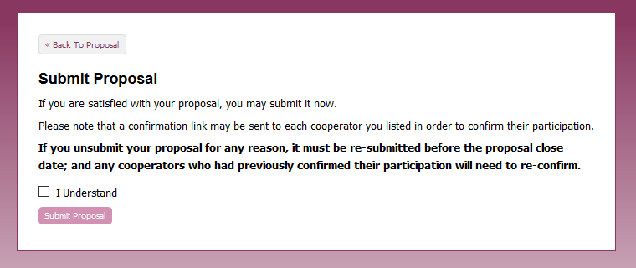
Once you are satisfied with your proposal, check “I understand” and click “Submit Proposal.” Note that in this system, you do have the ability to “unsubmit” and make corrections BEFORE the close date.
Notes:
You’ll land on this page to complete submission. Click “I understand”, then submit proposal. You do have the ability to unsubmit and make changes prior to the closing date for the grant program.

Slide 32
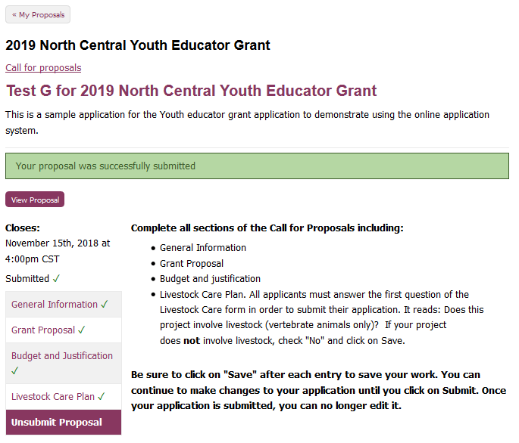
You will land on this web page, confirming your submission. Note that you can “Unsubmit” and make corrections and then “Submit,” but you must resubmit prior to the close date.
You will also receive an email confirming your submission.
Notes:
You will see this confirmation page. Note that in this system, you can “unsubmit” and make changes PRIOR to the closing date for the grant program. Make sure you resubmit by the closing date and time.

Slide 33
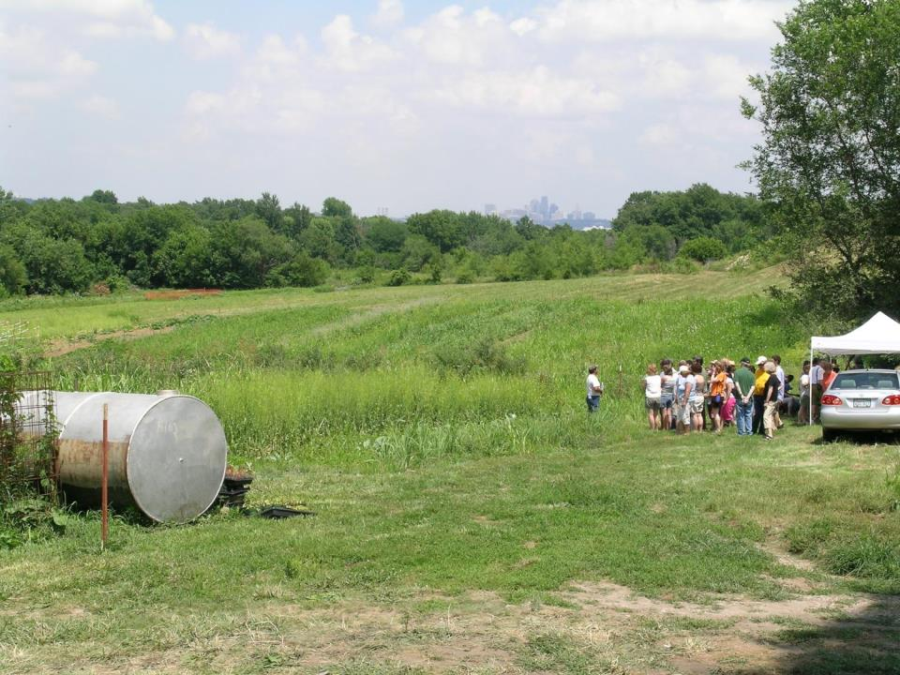
Good luck with your proposal!
If you have questions contact:
by phone: 612.626.3113
by email: ncrsare@umn.edu
www.northcentralsare.org
Follow us on:
photo credit: Joan Benjamin
Notes:
Congratulations! You have now successfully submitted your Youth Educator Grant Proposal. A committee of farmers, ranchers, educators, researchers, and others with an interest in youth education will review the proposals and make funding recommendations to the NCR-SARE Administrative Council. The Administrative Council members make the final funding decisions. Awards will be announced by the end of March 2019. If you have any questions contact NCR-SARE. Good luck with your proposal.

